Slide 1
CSPro 7.X
Training presentation

Slide 2
Lesson 1
QUESTIONNAIRES & CAPI

Slide 3
Questionnaire
Opinions
Preferences
Experiences
Intentions
Behaviour
Set of written questions designed to gather standardized information about population:

Slide 4
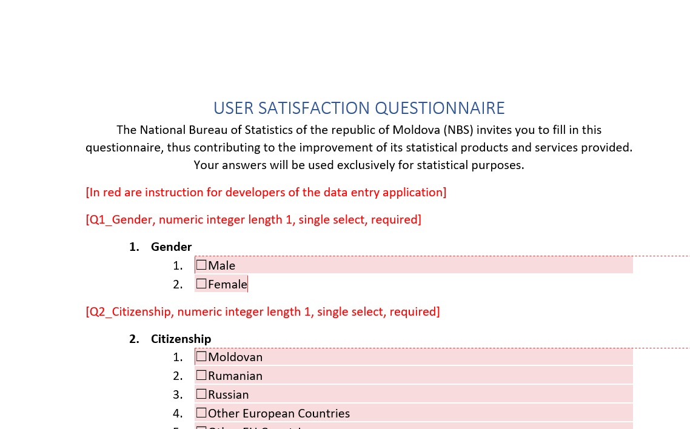
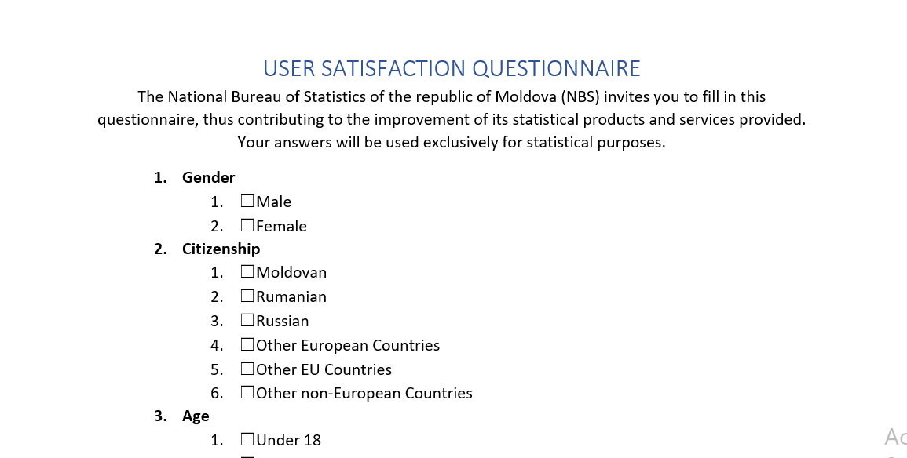
Questionnaire

Slide 5
Questionnaire Design Steps
Aims
Identify your research aims and the goal of your questionnaire
Population
Define your target respondents (population)
Collection Method
Choose the appropriate data collection method
Develop questions
Question Type
Choose your question type
Design question sequence and overall layout
Run a pilot
Questions
Pilot
Layout

Slide 6
Question types
Closed
Open-ended
Open response option (combination of both)
Additional types

Slide 7
Closed Questions
Single choice
Multiple choices
Ranking
Rating
Boolean (Binary)

Slide 8
Open questions
Free Text
Numeric

Slide 9
Open response option
Single Choice (includes “Other Specify”)
Multiple Choice (includes “Other Specify”)

Slide 10
Single Choice Questions
A single choice that can be selected from a list of predefined answers
Valueset as value:text (key:value, code:value) pairs
Response value (key, code) is usually stored in database as integer number or character

Slide 11
Multiple Choice Question
More then one answers can be selected from a list of predefined answers
Valueset as (value:text, code:value, key:value) pairs
In database answers are stored as array of (keys, codes, values)
Usually integers or characters are used as (key, code, value)
CSPro recommends char

Slide 12
Ranking Questions
Sorting all alternatives to a defined criteria, often by giving a score from 1 to the total number of the alternatives

Slide 13
Rating questions
A question where the user has to rate often from 1 to 5 (think of 5* rating)
1 – meaning Lowest (worst, strongly disagree…)
5 – meaning Highest (best, strongly agree…)
Can be stored as numeric field with validation range 1:5

Slide 14
Boolean Question
Special case of single choice questions with fixed valueset
0:False:No:Dissagree
1:True:Yes:Agree
Binary or Boolean field can be used to store this information

Slide 15
Text Questions
Usually stored as string
Alphanumeric
Free text, usually the responded can enter its free opinion
Subtypes (usually validated with regex):
Email
Address
Phone, Mobile
URL
…

Slide 16
Numeric Question
Examples (can be validated with min and max values, ranges):
Age
Salary
Scores
Weight
Height
…
Usually stored as number
Integers
Decimal point number

Slide 17
Repeated Group of Questions (Roster)
A group of questions that can be repeated
Usually for each family member (variable repetition)
Or each agriculture crop (fixed repetition)
CSPro uses roster type to save this kind of questions
Used a lot at NBS

Slide 18
Matrix questions
List of closed questions that has the same predefined answers
Questions are listed as rows
Predefined answers are listed as columns

Slide 19
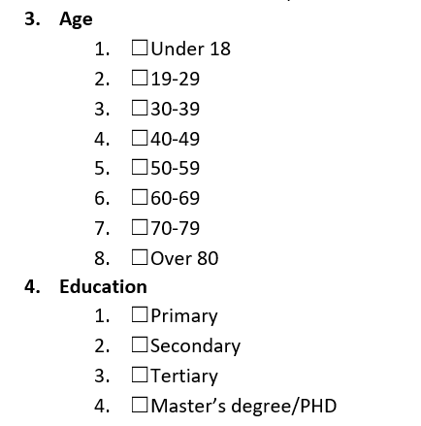
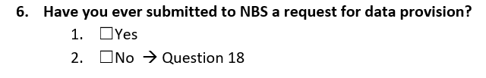
Questionnaire Logic
Directly visible in the questionnaire design
Deduced

Slide 20
Questionnaire logic
Skip to
Possible when the structure of the survey is already defined
Logic based on previous and self questions
Skip to an upcoming question
Ask if
On the go
Logic based on previous questions:
Visible if
Enabled if
Required if

Slide 21
Data Collection Methods
Self-Administrated Questionnaires
Interviewer-Administrated Questionnaires
PAPI
CAWI
PAPI
CAPI
CATI

Slide 22
CAPI
Computer-assisted personal interviewing (CAPI)
Display the questions to be asked by interviewers
Record the answers of the respondents
Datasets are ready for analysis, and for interpretation

Slide 23
CAPI Advantages
Data quality
Data security
Cost effectiveness
Additional data types
Preloading of data
Timeliness

Slide 24
CAPI Workflow
Design the questionnaire in a word processing or spreadsheet application (in the master language)
Translate the master questionnaire into any required additional language
Build the data entry system to match the master questionnaire’s content and features
Ensure it is working as intended in the master questionnaire
insert the additional language versions into the system
install the survey on tablets
Pilot testing
Actual field work

Slide 25
Additional Data Types
Geographical (point, line, polygon, country, city, address, gps)
Time (date, datetime, time)
Audio (voice recording)
Video (video recording)
Image (camera picture)
Signature
File (file upload)…

Slide 26
Geographic Question
Usually
Country
City
Address
Point in map
Line
Polygon
GPS coordinates
Country, city and address can be represented with text or codes
Point, Line and Polygon are usually represented by one or many latitude and longitude pairs

Slide 27
Time Questions
Usually
Date
Datetime
Local datetime
Timestamp
Year
Datetime, Date, Local Datetime can be usually stored as formatted string(text) DD/MM/YYYYTHH:mm:ssZ
Timestamp or year can be represented with numbers

Slide 28
Question validation
Closed questions: the respondent can not choose other then predefined answers
For open questions
Open text questions can be validated using regex
Open number questions can be validated using ranges
Geographic questions can be validated to be inside a geographical area
Time questions can be validated using a time range…

Slide 29
Homework
User Satisfaction Survey Questionnaire

